Slide 1

Designing Research
Funding Programs to
Enable Research Impact
David Phipps, Ph.D., MBA,
Asst. VP Research Strategy & Impact, York University
Network Director, Research Impact Canada

Slide 2




Transformation stream grants will support projects that tackle a well-defined problem or challenge
SSHRC PG Cross-sector co-creation of knowledge and understanding: Partnerships that use ongoing collaboration and mutual learning to foster innovative research, training and the co-creation of new knowledge on critical issues of intellectual, social, economic and cultural significance.
SPG-N: The goal of NSERC’s Strategic Partnership Grants is to increase research and training in targeted areas that could strongly enhance Canada’s economy, society and/or environment within the next 10 years.

Slide 3
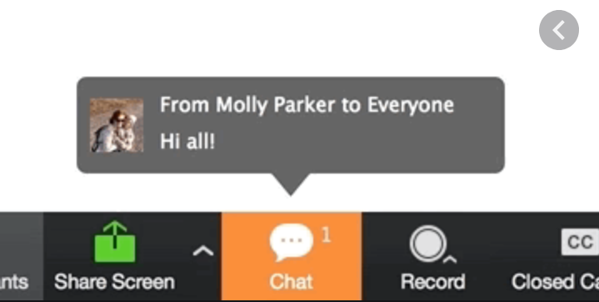

1. In the chat: Yes/No/Don’t know
Does your country have research funding programs that are designed to fund research that addresses a particular economic, social, environmental, health need
2. Volunteer to describe a research to impact program:
Goal/Objective
Role of partners
Expectations for impact strategy
Impact assessment

Slide 4


Slide 5
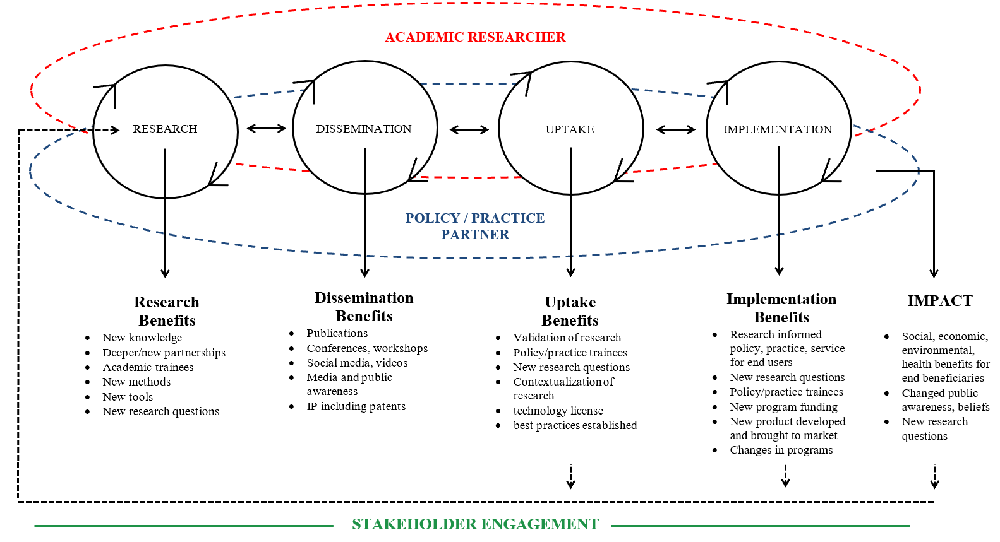
Co Produced Pathway to Impact

Slide 6









Slide 7


Slide 8
Elements of a “research for impact” funding program
(will include lots of stuff but relevant to impact…)
Call for applications
Guidance
Impact strategy
Peer review
Reporting

Slide 9

Elements of a “research for impact” funding program
(will include lots of stuff but relevant to impact…)
Call for applications
Guidance
Impact strategy
Peer review
Reporting
Be clear on what you mean by impact
Definition “provable benefits of research in the real world”
Align the objectives of the program with impact as well as with research
  Researchers are really smart but you need to tell them specifically what the funding program is for
Any impact OR specific need driven by national priorities
Integrated impact strategy or stand alone impact strategy?
Title of program should indicate the intention i.e. SSHRC Partnership Grant
Should this even be called a research grant i.e. Impact Accelerator Grant (others?)

Slide 10

Elements of a “research for impact” funding program
(will include lots of stuff but relevant to impact…)
Call for applications
Guidance
Impact strategy
Peer review
Reporting
Your best guidance can only be generic
How to create impact for automotive manufacturing is different than impact for affordable housing but the guidance must apply to both
Principles:
  No templated approaches – need a unique impact strategy (see next slide)
  Should be grounded in literature on impact
  Refer to a framework for applicants to use should they choose
  Should have appropriate expertise*
  Eligible expenses in budget
* Not usually the lead researcher

Slide 11

Elements of a “research for impact” funding program
(will include lots of stuff but relevant to impact…)
Call for applications
Guidance
Impact strategy
Peer review
Reporting
Impact Strategy should have
Partners/audiences (note next slides)
Goals
Activities
Evaluation/impact assessment
Budget

Slide 12
Segment your “partners”
stakeholders
listen to
audiences / receptors
disseminate to
co-production partners
work with

Slide 13
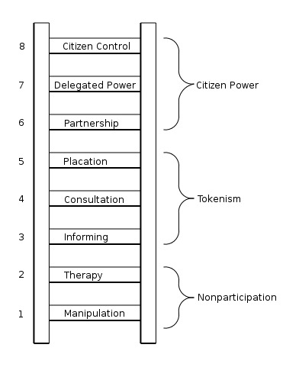
Accountability & Authority
Governing Board Position
Governing Board Co-Chair
Co-applicant
Accountability without Authority
Partner Advisory Board
Patient Public Involvement (i.e. CIHR SPOR)
“collaborator” or “partner”

Slide 14

Elements of a “research for impact” funding program
(will include lots of stuff but relevant to impact…)
Call for applications
Guidance
Impact strategy
Peer review
Reporting
Peer Review
Who are the “peers” in partnered grant programs
Balance power differentials if using public, patient, stakeholder reviewers. Give non-academic reviewers a decision:
  Review before (gate keeper)
  Review in parallel but separate (risk of conflict)
  Review last (final decision)
Compensate non-academic reviewers
Build capacity for non-academic reviewers but “unlearn” the academic reviewers
Power and Privilege in Peer Review http://researchimpact.ca/power-and-privilege-in-peer-review/

Slide 15

Elements of a “research for impact” funding program
(will include lots of stuff but relevant to impact…)
Call for applications
Guidance
Impact strategy
Peer review
Reporting
Reporting considerations
Ask them for the information you need to report
Align reporting to their pathway to impact
  Process indicators in first few years (no impact yet) – quantitative metrics describing activities
  Call for indicators of engagement not just impact – quatitative for engagement activities, qualitative including testimonials
Narrative case studies for implementation and impact
  provide a standard case study format and guidance
  no numbers without stories, no stories without numbers

Slide 16


Slide 17

15 minutes
Breakout room by delegation (or breakout group)
What partnered/impact grant programs do you have?
Based on this presentation and your homework, what (if anything) needs to change to better support “research for impact” projects
What (if anything) can you change to better support “research for impact” projects
What will be some barriers to #3

Slide 19

@researchimpact

